Slide 1
Structure and outline for today.
Morning lecture/lab:
Introduction to shotgun metagenomics: The top 10 reasons why shotgun metagenomics is awesome!! - Titus
K-mers; and Dude, what’s in my metagenome? (part i) – Titus
Afternoon lecture/lab:
Detecting and accounting for sample contamination – Ben
mostly 16S-focused
Evening open lab:
Working through tutorials – R, 16S, low-level shotgun data analysis. (Ben, Titus, Maria et al.)
Evening social:
Maybe a social game (werewolf)? ~8pm?

Slide 2
Introduction to Metagenomics
Titus Brown
MBL STAMPS 7/20/24

Slide 3
Hello and welcome!
Your questions are a big part of the point of this lecture!
Shotgun metagenomics is challenging, and even the most basic data understanding and analysis are hard.
Today I am hoping to give you a foundation in what shotgun metagenomes are, and some intuition in how to think about their contents!
This is a new lecture, specially crafted for STAMPS 2024 – please ask questions and provide feedback!!
Annotated slides will be available after lecture.
(Join me for lunch?)
I am happy to do 1:1 or small-group whiteboarding/discussions on Sat or Mon evening on these topics, too!

Slide 4
I. The top 10 reasons why shotgun metagenomics is awesome!
Metagenomics samples everything!
Classifying genomes and metagenome content has become relatively straightforward and accurate.
Sequencing technology is improving fast!
Bioinformatics technology is improving quickly!
Metagenomics is differently biased from targeted approaches.
You can recover (dramatically) new genomes from metagenomes!
You can reuse metagenome data later in some very useful ways.
Metagenomics gets you down to strain level detection, in theory and maybe in practice.
It is theoretically and practically possible to do many different things with metagenomic data!
Shotgun metagenomicists are united by its difficulty!

Slide 5
1. Metagenomics samples everything!
Within the limits of sample diversity and molecule “type” (DNA by default), shotgun metagenomics samples everything.
This includes viruses, bacteria, archaea, and eukaryotes…
…as well as “garbage”
Degraded DNA/RNA
Contaminants and unintended companions
…as long as you sequence deeply enough.

Slide 6
Why is 16S so much deeper than shotgun metagenomics for community sampling??
Consider a mixture of 1000 genomes, each 1 MB in size, all equimolar.
Sequencing all 1000 genomes to 1x coverage would require a billion base pairs (1000 genomes x 1 million bases).
Instead, if you can select a 1 kb region as “diagnostic” of genome presence, you can sequence just a million base pairs to get that same answer.

Slide 7
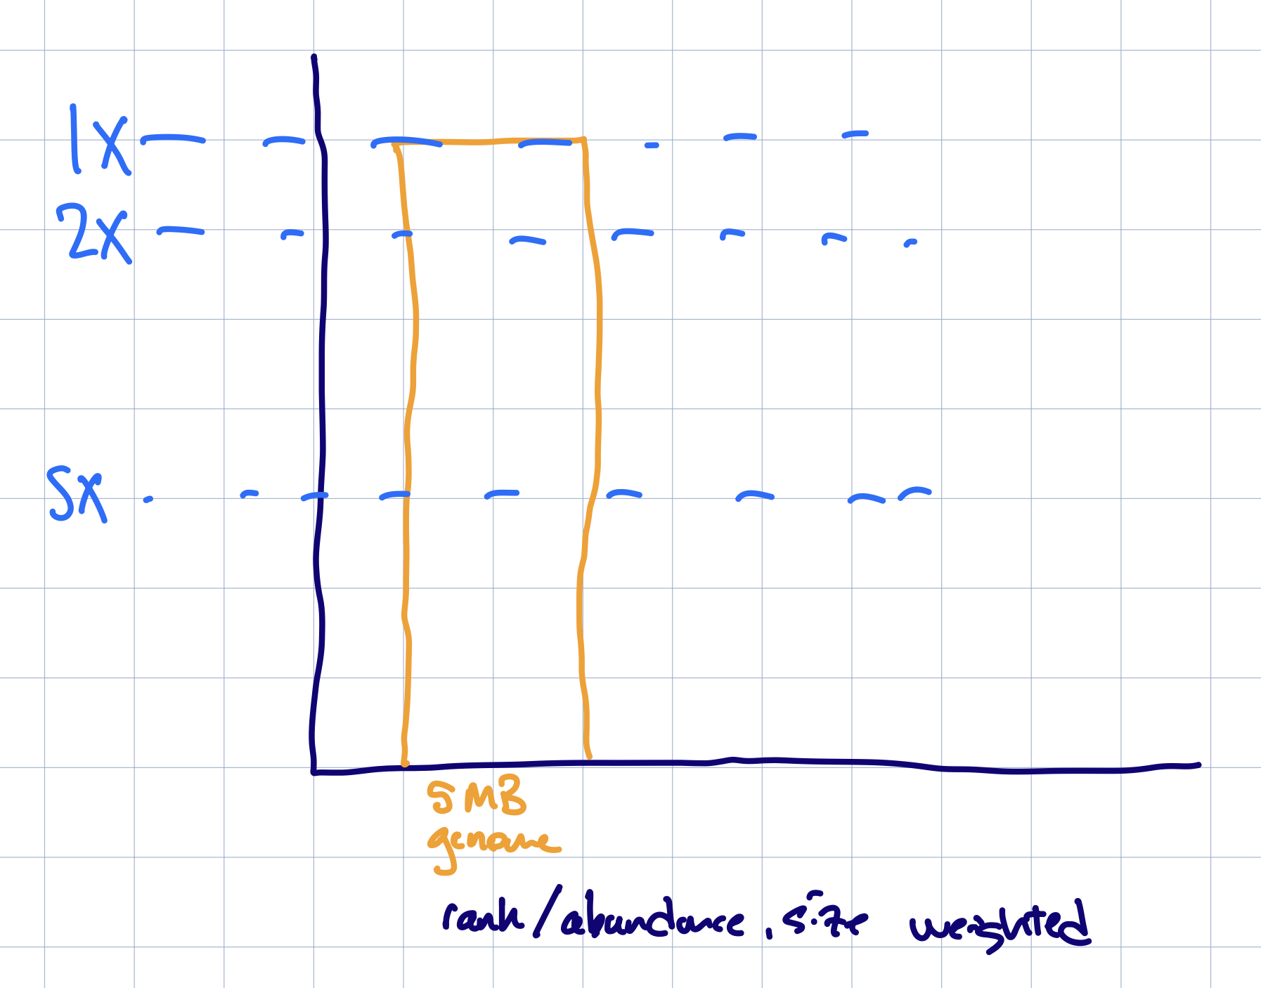
Sequencing depth and sample diversity (1)

Slide 8
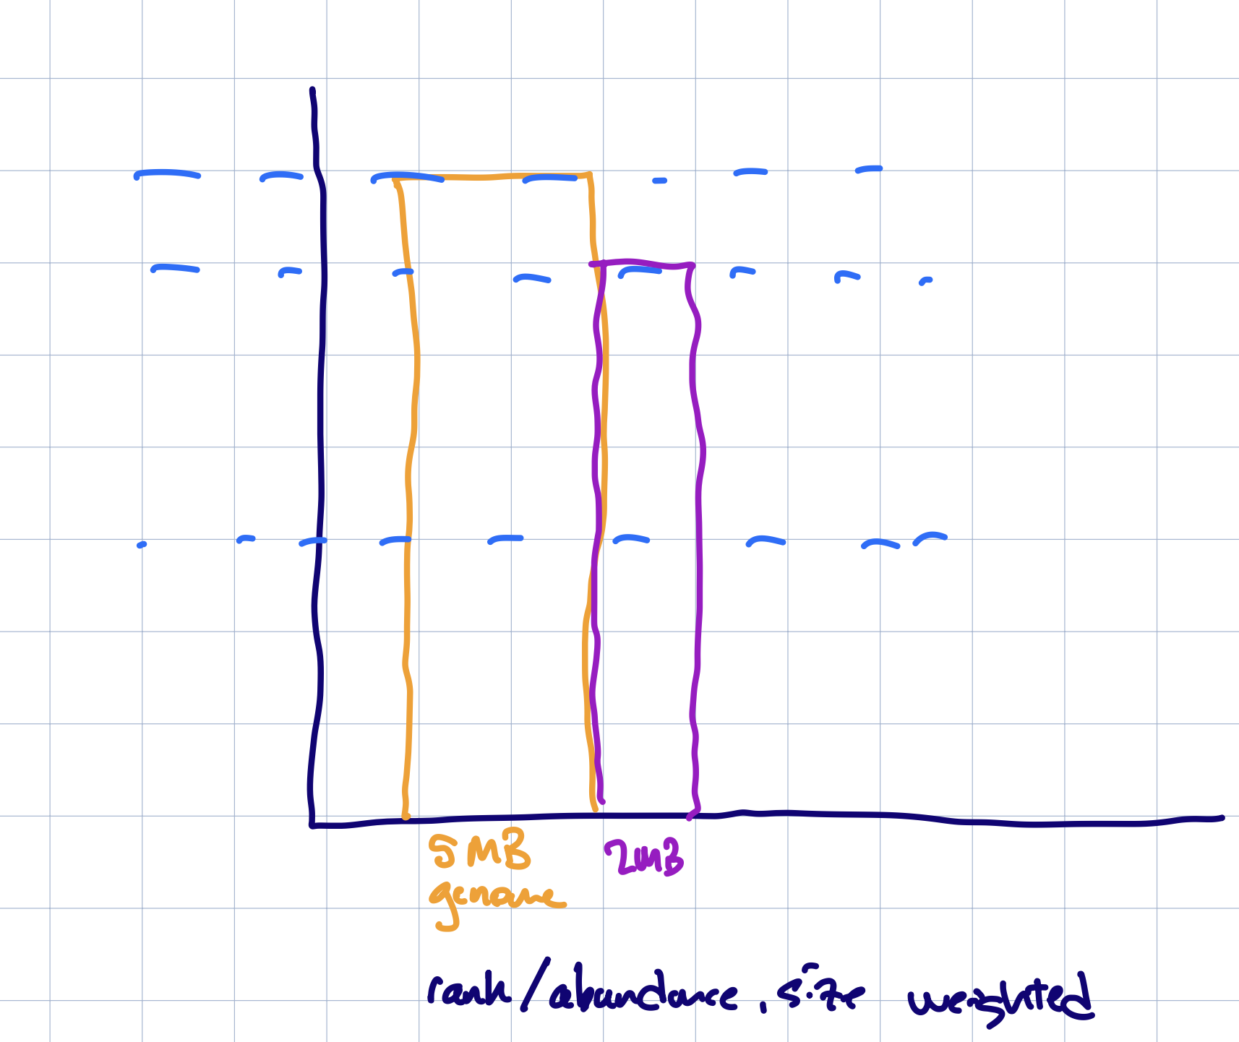
Sequencing depth and sample diversity (2)

Slide 9
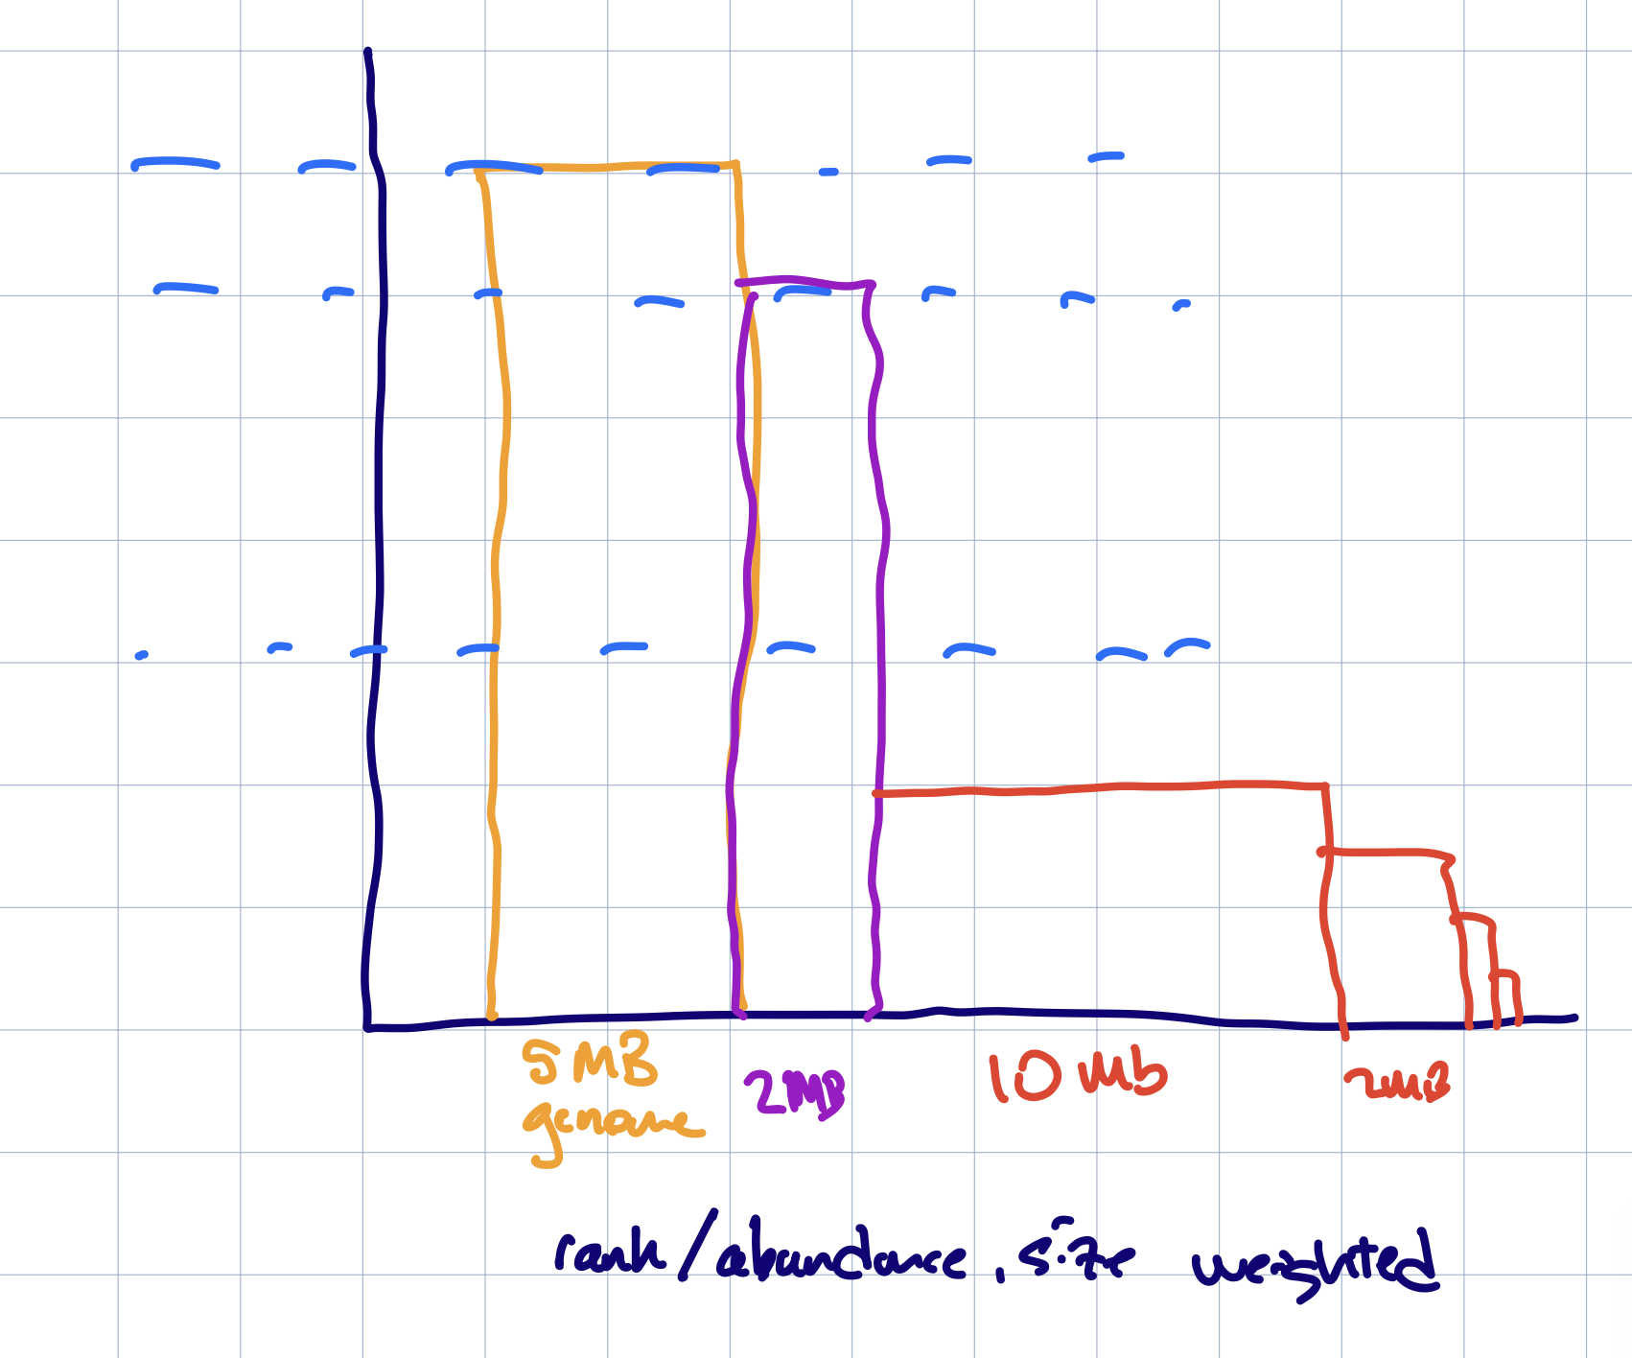
Sequencing depth and sample diversity (3)

Slide 10
How deeply should I sequence??
The measure is “bp generated”. But:
There is no straightforward empirical answer:
Unknown contents (including things that 16S can’t detect).
Sample and sequencing variability.
Strain level heterogeneity.
The best practical answer is:
Target 2x what other people have used when working on similar samples.
Mix and match approaches and technology, e.g.
16S for many samples, shotgun metagenomics for a few samples to provide references.
Short reads for sample characterization, long reads for genome recovery.
I might suggest an 80/20 perspective: focus 80% of your effort on addressing your core questions, and 20% on cool new stuff.
Remember that generating data is just the beginning: you also need to be able to analyze it and reach robust conclusions…

Slide 11
2. Classifying genomes and metagenome content has become relatively straightforward and accurate.
A few big changes in recent years:
The GTDB taxonomy (for bacteria and archaea) is great!
Species-level classifications are based on genome sequence, unlike NCBI; this makes it possible for sequence-based analysis tools to perform well.
Higher-level (class, order, etc.) classifications are based on ribosomal proteins, and tools to do that well are also readily available and becoming faster (GTDB-Tk, SingleM, FastAAI).
Large numbers of genomes are increasingly available (~3m) which makes it possible to do ~perfect species level classification.
Metagenomic classification works increasingly well.

Slide 12
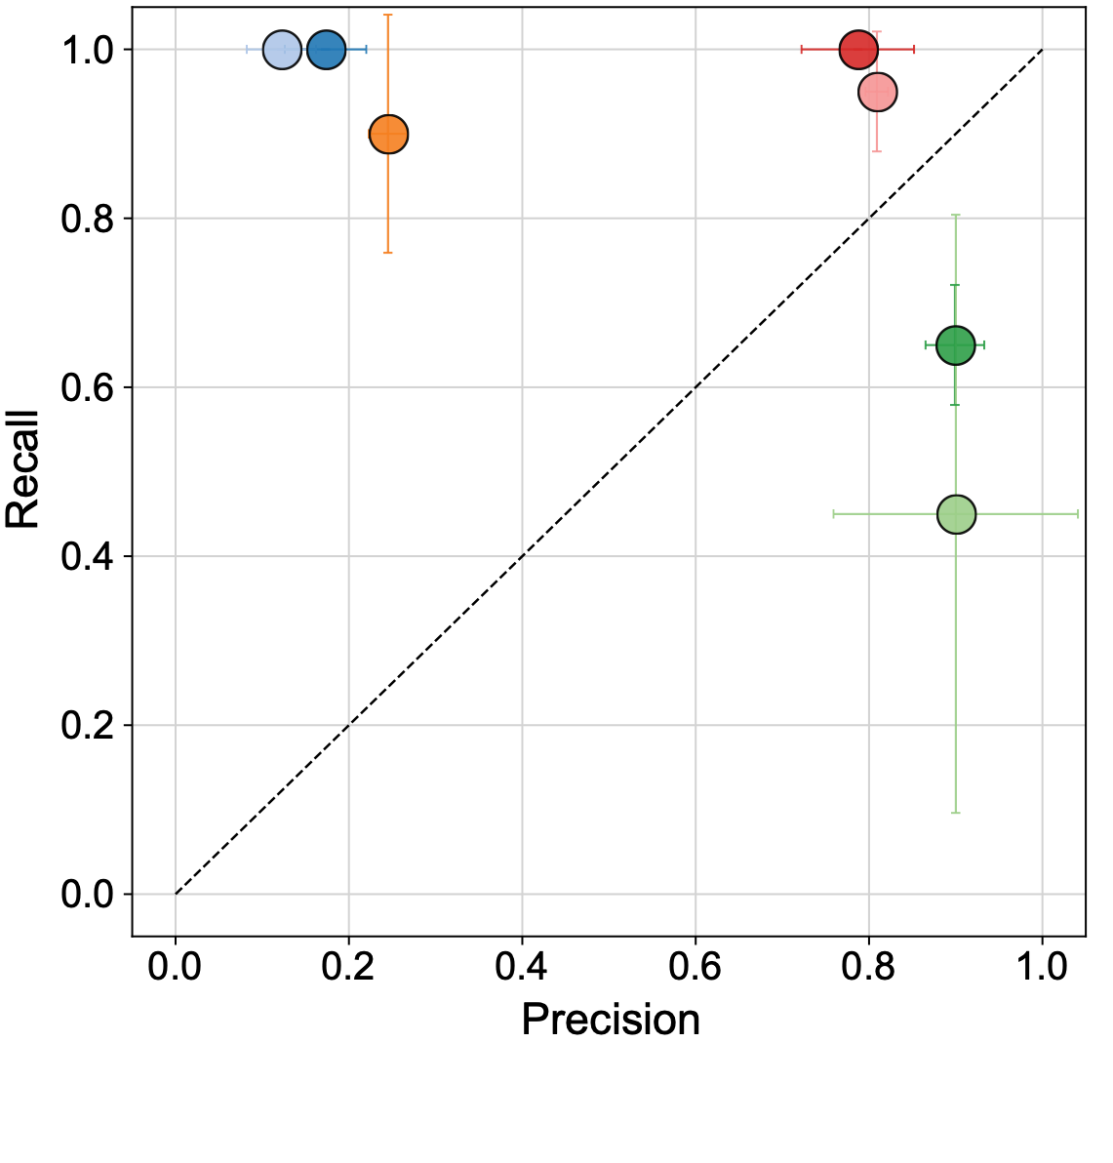
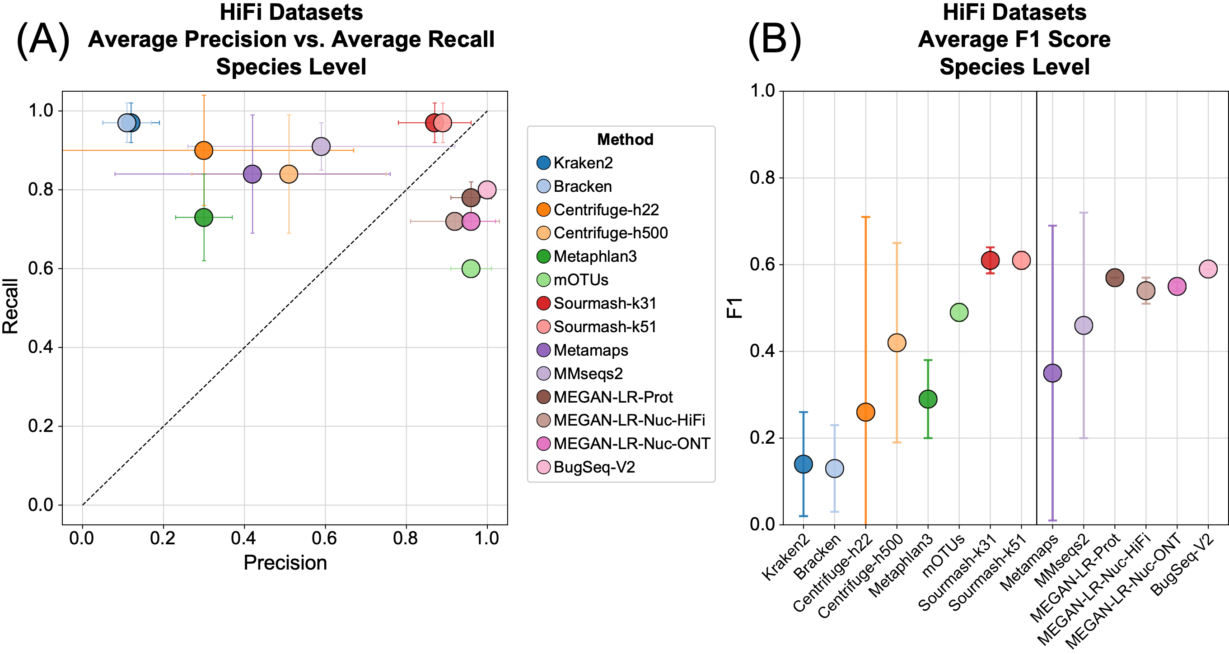
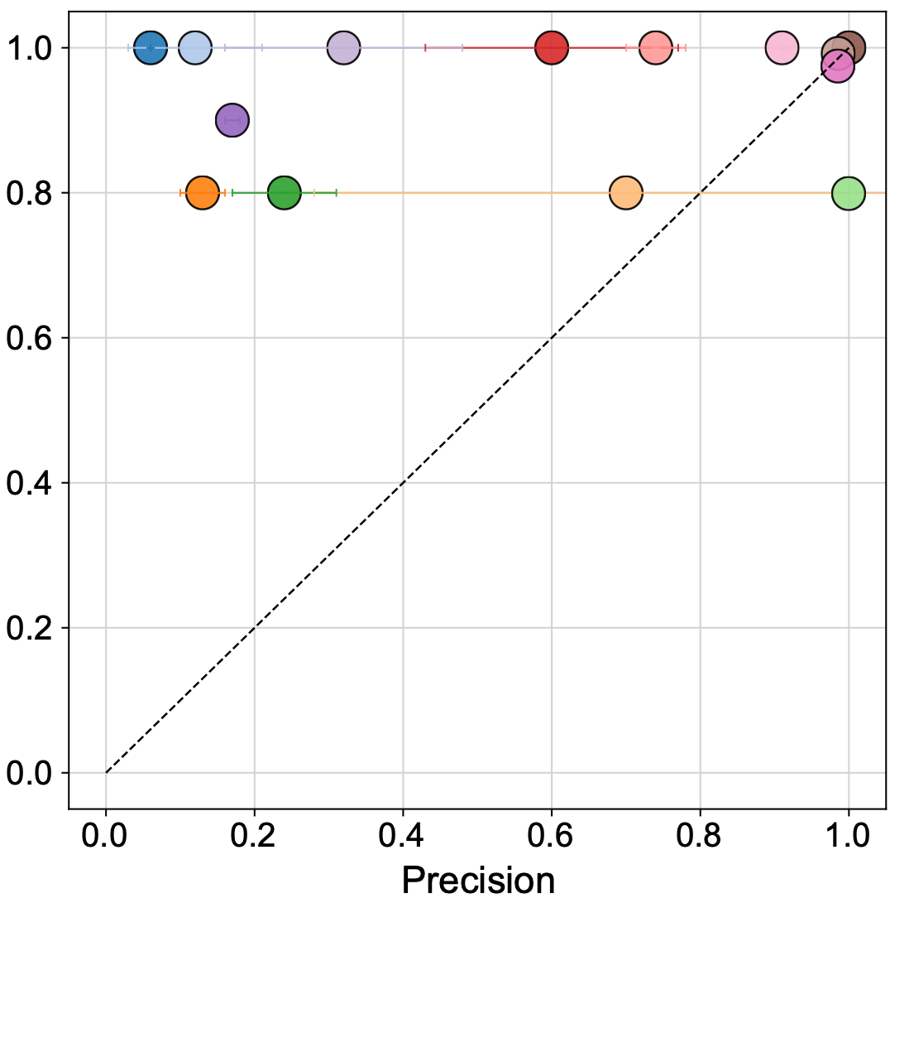
There are sensitive and specific options for taxonomic classification of metagenomes.
Illumina
PacBio HiFi
Oxford Nanopore (R10.3, Q20)
Portik et al., 2022

Slide 13
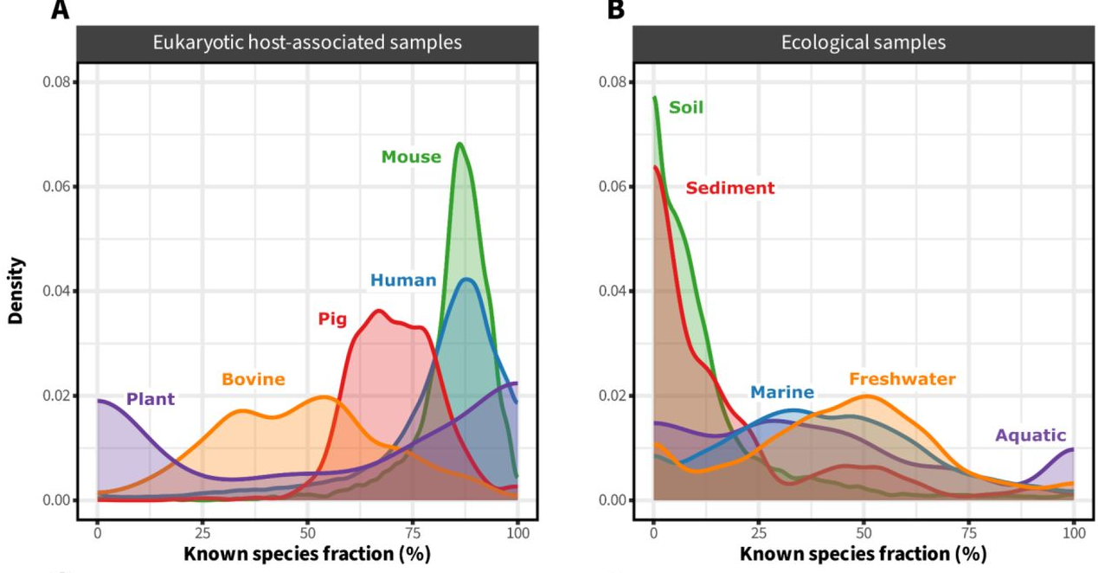
The landscape of metagenome classification
(Sandpiper & singleM are fantastic!!)
doi: 10.1101/2024.01.30.578060

Slide 14
Remaining frontiers in taxonomy -
We need better characterization of genomes relevant to environmental samples! (But this will come.)
GTDB only covers bacteria and archaea…
Viral taxonomy is really hard, because viruses are incredibly variable; this area is undergoing rapid development!
Eukaryotic taxonomy needs development as well. (I know very little about the challenges here.)
Strain level classification is important, challenging and (potentially) non-sensical due to genome mixing.

Slide 15
3. Sequencing technology is improving fast!
Ben covered this really well, but PacBio HiFi gives you basically “perfect” genomes, and sequencing costs are dropping.
If you can use short-read sequencing (e.g. for taxonomic and functional profiling), then life is pretty good, I think.
But, remaining challenges combine synergistically ☹
The cost of HiFi is high.
Sample concentration required is unreachable for some samples.
Metagenomic complexity (diversity & richness) for some samples (soil, sediment, maybe water) is hundreds to thousands of times higher than (e.g.) gut.
Multiple strains challenge even long-read assembly.
See Feng & Li, 2024, doi: 10.1186/s13059-024-03234-6
Will be discussed on Monday by Todd et al.

Slide 16
4. Bioinformatics technology is improving quickly!
There is a profusion of tools to do your initial data analyses, whatever they may be!
Conda has made it straightforward to install most command-line tools.
That having been said,
Sorting out which programs to use is definitely a challenge 😭.
My recommendation is to start your journey with a tool that
Has worked for someone else, preferably in similar circumstances.
Executes to completion.
Gives you useful output.
Has decent documentation.

Slide 17
5. Metagenomics is differently biased
Targeted approaches (typically based on PCR or array capture) typically rely on ultraconserved regions.
This privileges what is already known.
In particular, “primer bias” can lead to emphasizing measurement of what we already know pretty well.
16S also falls afoul of copy number variability: the number of (identical) 16S regions in a bacterial genome can vary ~10 fold within a species.
Shotgun metagenomics is not unbiased by any means, but has a different bias - typically related to GC content in DNA, as well as other details of the sample processing specific to shotgun sequencing.

Slide 18
Some reading!
Wavy coverage patterns in mapping results – A. Murat Eren (Meren). link
Consistent and correctable bias in metagenomic sequencing experiments, McLaren, Willis, and Callahan, 2019.
tl;dr a really nice summary of sources of bias in metagenomic experiments.
Nitrogen-fixing populations of Planctomycetes and Proteobacteria are abundant in surface ocean metagenomes, Delmont et al., 2018.
- tl;dr amplicon-based strategies of measurement systematically underestimated the abundance of diazotrophic heterotrophs in the ocean for decades.

Slide 19
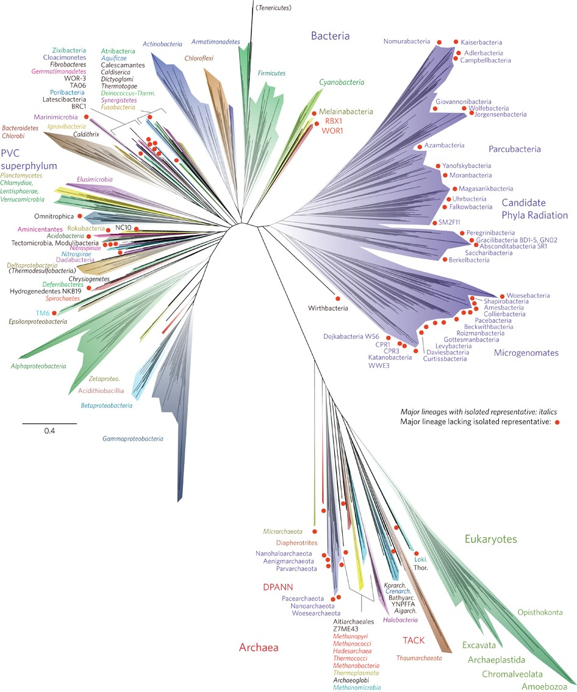
6. You can recover (dramatically) new genomes from metagenomes!
Metagenome-assembled genomics (and other related methods) have been pulling an increasing number of Very Different bacterial, archaeal, viral, and even eukaryotic genomes from metagenome samples.
(Methods will be discussed on Monday!)
Hug et al., 2016. doi: 10.1038/nmicrobiol.2016.48

Slide 20
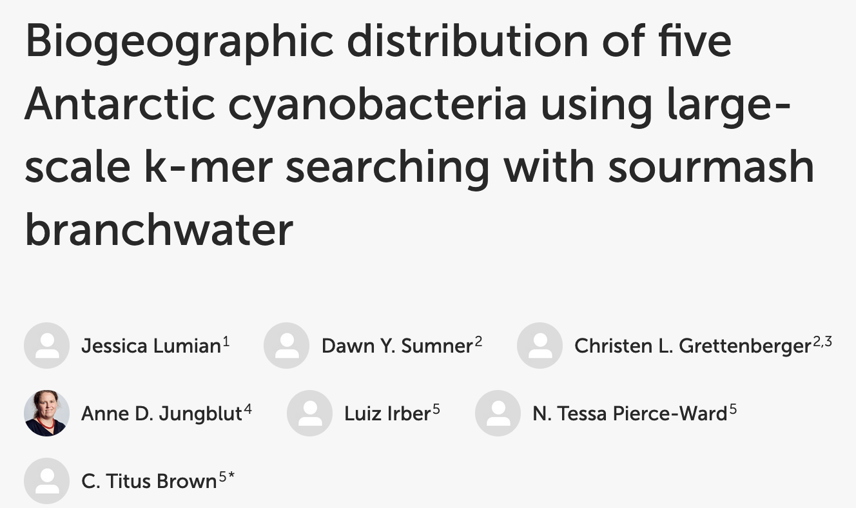
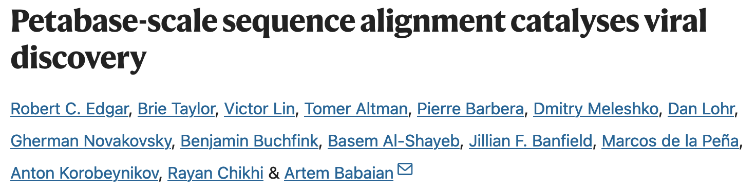
7. You can reuse metagenome data later in some very useful ways.
Publicly available metagenomes remain very useful for a variety of new analyses years after they are published!
doi: 10.3389/fmicb.2024.1328083
doi: 10.1038/s41586-021-04332-2

Slide 21
(demo: https://branchwater.jgi.doe.gov/)

Slide 22
8. Metagenomics gets you down to strain level detection, in theory and maybe in practice.
16S can resolve genera and some species, but not below.
Shotgun metagenomics can sensitively determine presence/absence and abundance of specific genomes, and hence can resolve strains.
From a bioinformatics perspective, this is a ~solved problem, I think.
Biology disagrees ☹
The genomic content of metagenomes is rarely a perfect match to your reference sequence!
Genomes seem to remix and recombine at the species level.
Also: recovering new strain-level genomes from metagenomes is hard.
Both Todd and I will discuss all of this more (and maybe disagree!) on Monday.

Slide 23
9. It is theoretically and practically possible to do many different things with metagenomic data!
Community diversity/richness.
Analysis of known bac/arc/viral/euk presence/absence.
Abundance of genomes.
Detection of core/accessory elements (pangenomics).
Analysis of functional content.
Analysis of Antimicrobial Resistance Genes.
Discovery of novel proteins and pathways (e.g. biosynthetic gene clusters).
Corollary: Shotgun metagenomics offers many opportunities for bioinformatics “growth” 😅 😭.

Slide 24
10. Shotgun metagenomicists are united by its difficulty!
Methods developers for metagenomics are (in my experience) mostly just thankful to get a result that is not wildly wrong, and are friendly and helpful (perhaps as a result?)
There are a bunch of rich, powerful techniques that we can mix and match to get answers!
Mapping
Assembly, binning
K-mers
…but applying them appropriately remains an ongoing challenge.
Scale (10s of millions of genomes, millions of samples, extremely large sequence data sets) is an ongoing challenge as well.

Slide 25
II. Dude, what’s in my metagenome? (part i)
Interrogating metagenomes through k-mers for fun and nonprofit!
K-mer based techniques provide sensitive and specific ways to analyze “raw” genome and shotgun metagenome content.
These are really low-level and granular analyses; today is mostly about building intuition and understanding, not about high-level characterization!

Slide 26
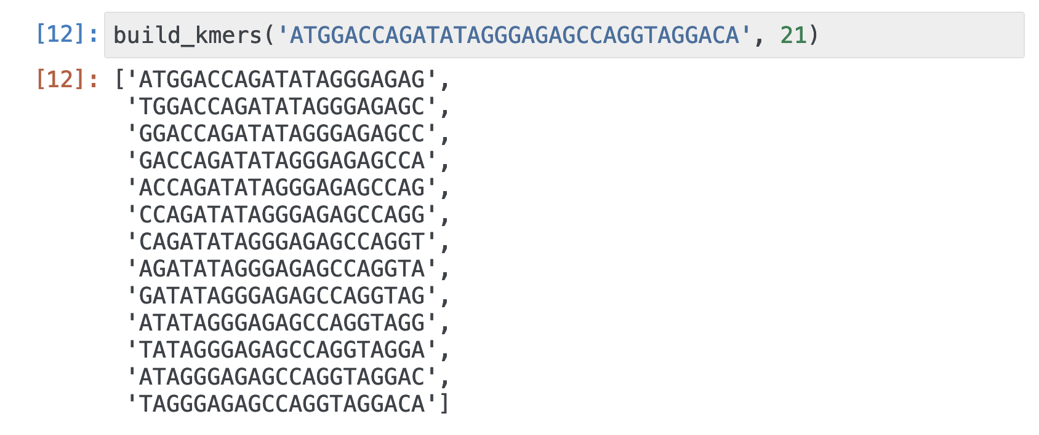
What are k-mers?
Fixed-length “words” of DNA that are extracted by sliding a window along sequence.
“k” is the window size.

Slide 27
What are k-mers? Features of note:
Can be generated from any sequence – in particular, both assembled genomes/metagenomes, and unassembled data sets.
(We will talk more about assembly on Monday!)
K-mer matching between samples is based on identity – 100% match.
DNA k-mers are typically ”collapsed” around reverse-complement matches (e.g. we regard ATGCCC as equivalent to GGGCAT).
We often use odd k-mer sizes to avoid DNA palindromes.
You can also extract k-mers from protein sequences, but for today we will focus on DNA k-mers.

Slide 28
K-mers are really sensitive and really specific (in theory)
There are 4,398,046,511,104 possible k-mers of size 21 (1 / 4**21)
You would expect approximately 5 k-mers to be shared between two unrelated genomes, each of size 5 MB.
There are 4,611,686,018,427,387,904 possible k-mers of size 31.
E = 5 x 10⁻⁶ for two k-mers to be shared.
Mathematically, it is easy to make k-mers really specific!
And, for perfect sequence, you can “call” a match based on a single observation => sensitivity.
But does biology agree?

Slide 29
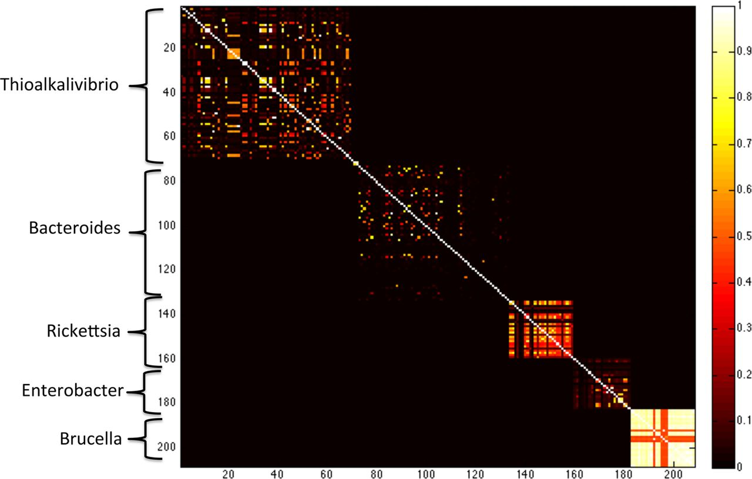
K-mers are really sensitive and can be really specific (in practice)
K-mers are very species specific when they are long enough!
(Here: k=40.)
K=21 – genus
K=31 – species
K=51 – strain
Koslicki and Falush, doi: 10.1128/msystems.00020-16

Slide 30
Notice! The highest-recall methods for taxonomic classification are k-mer based!
Illumina
PacBio HiFi
Oxford Nanopore (R10.3, Q20)
Portik et al., 2022

Slide 31
Computers (and computer scientists) like k-mers!
One parameter: k.
Exact matches are easy for everyone to understand!
You can convert k-mers into numbers via hashing and then just compare numbers. Computers like numbers.
Really efficient techniques for large-scale use via sketching.
We will discuss this more on Monday.

Slide 32
Two downsides of k-mers
There are lots of them and sequencing errors make more.

Slide 33
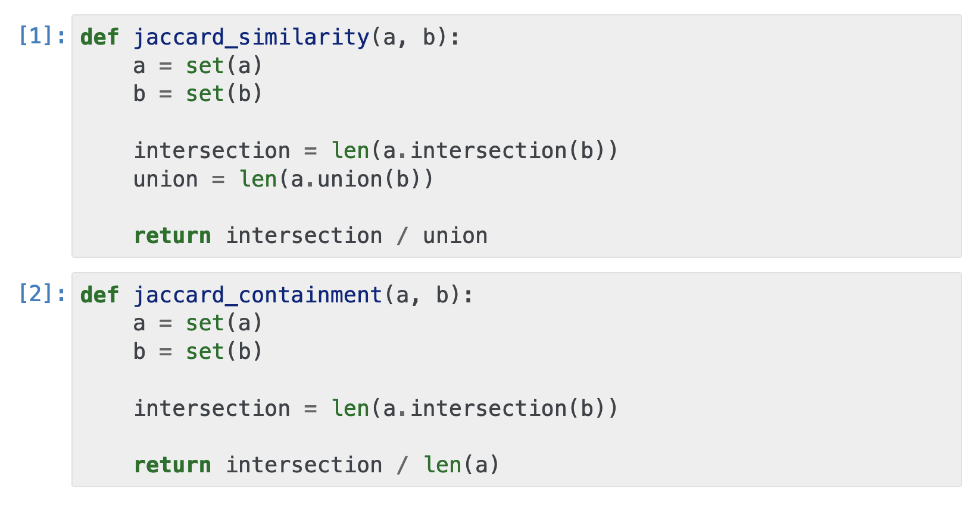
How do you compare collections of sequences using k-mers??
Set operations!
Note: Jaccard is a distance metric; containment is not.

Slide 34
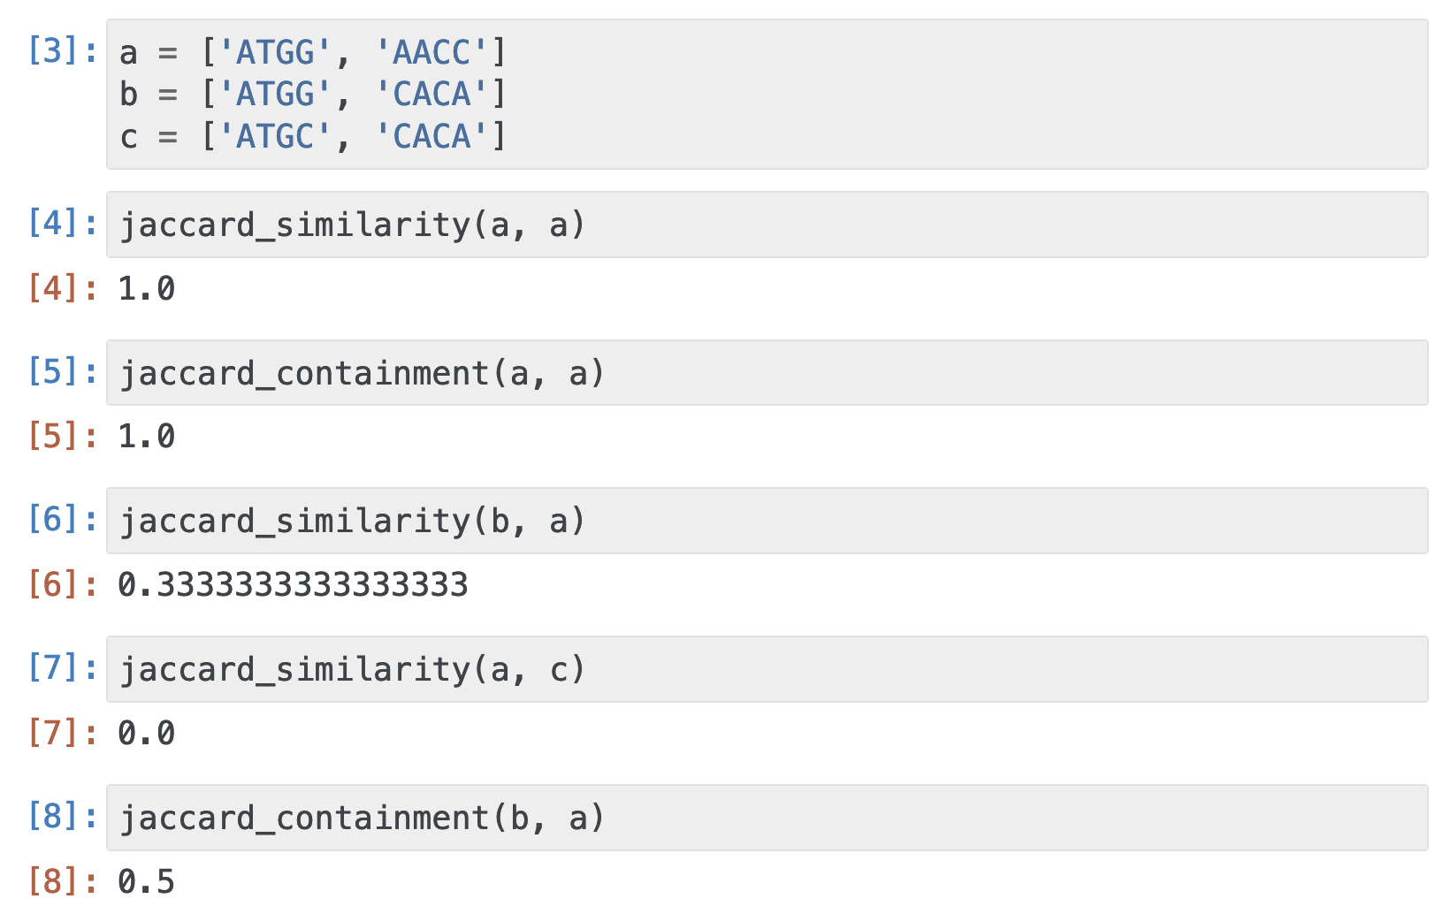

Slide 35
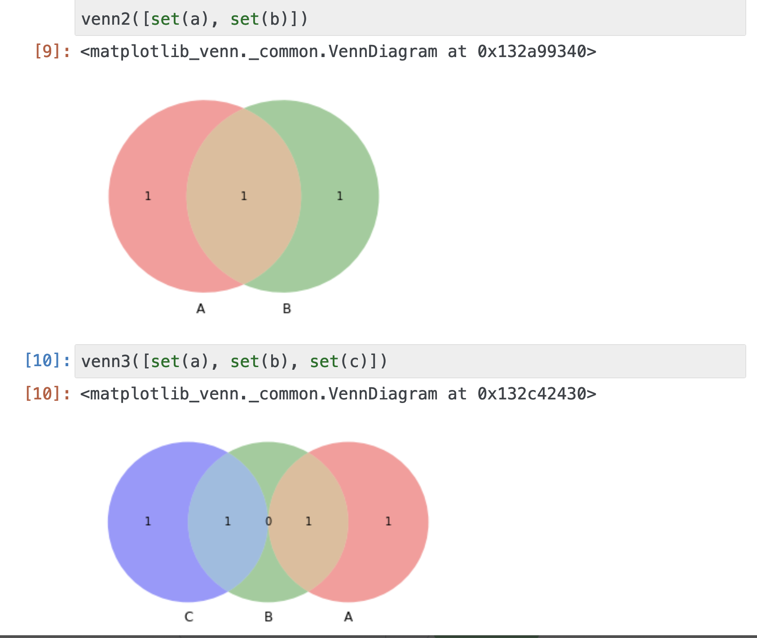

Slide 36
Digression: “Average Nucleotide Identity” vs k-mers
ANI is an alignment based measure of sequence similarity:
align two sequences (line them up with the smallest number of mismatches possible)
calculate the fraction of bases that are identical
~95% is considered “same species”
ANI has been shown to correlate well with hybridization-based measures of DNA similarity (“COT curves”)

Slide 37
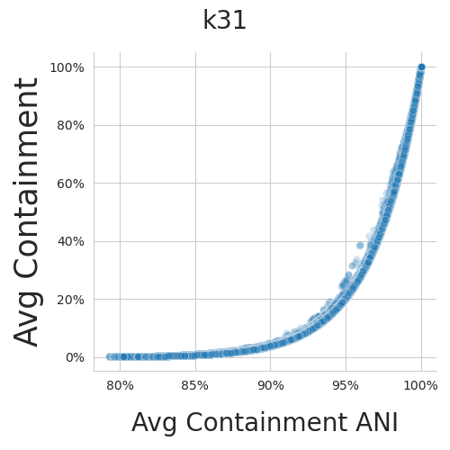
K-mer containment can be converted to/from Average Nucleotide Identity – they are log related.
K-mer containment is something we can calculate with our tool quickly and easily from unassembled sequence data.
Average Nucleotide Identity can usually only be calculated from assemblies.
But we can convert between alignment free and alignment-based measures!
Estimating the average containment to ANI relationship for k = 31
Work by Tessa Pierce-Ward, David Koslicki, and Mahmud Rahman.
Rahman Hera et al., 2022, https://doi.org/10.1101/2022.01.11.475870

Slide 38
Alignment-based vs k-mer-based (alignment-free)
tl;dr; They are interconvertible within a useful range!
ANI has trouble separating sequences with a very high level of similarity (99.9%, 99.99%, 99.999% …)
K-mers cannot robustly detect dissimilar sequences (< 90% ANI).
Use whatever technique works for your question of interest.
Increasingly, tool developers are mixing and matching k-mers and alignment based techniques behind the scenes anyway.
The biggest difference is that you do not need to assemble datasets to use k-mers 😁 😈

Slide 39
Multiplicity and k-mer abundance
The above measures (Jaccard, containment) are all “flat” - they operate on presence/absence of k-mers.
But for many situations (especially metagenomes!) you care how many times a sequence is present.
For k-mers, the equivalent is “multiplicity”.
This is a less-well-developed area, bioinformatically.
I refer to this as “abundance”, below.
(More this evening, or on Monday.)

Slide 40
Let’s compare some genomes and metagenomes!!!
These kinds of comparisons underlie many actual genomic metagenomic analyses:
Distance comparisons
Overlap/matching of content
Compositional analysis
…but are usually presented in summary form.
We’ll start at “base” of conceptual hierarchy of analyses, and try to connect to usual abstractions! Wish us luck!

Slide 41
We’re going to play a game!
I give you a diagram or picture with some details.
You think/pair/share:
1 minute of looking at diagram alone;
2-4 minutes of discussion and questions;
We discuss as a class!
Ask questions
Uncover assumptions
Delineate what can and can’t be inferred
(Note: You will be able to run these analyses yourself this evening!)
(Note 2: some of these analyses break my brain.)

Slide 42
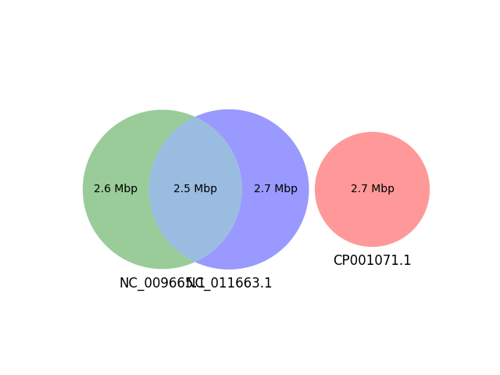
Diagram 0!
Here is a comparison of k-mers from three genomes, and their overlap!
k=31, DNA. No abundance.

Slide 43
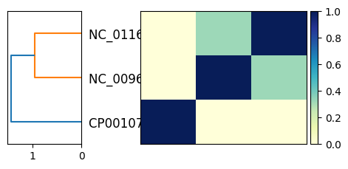
Diagram 0: Jaccard similarity matrix.

Slide 44
Diagram 0: Jaccard similarity

Slide 45
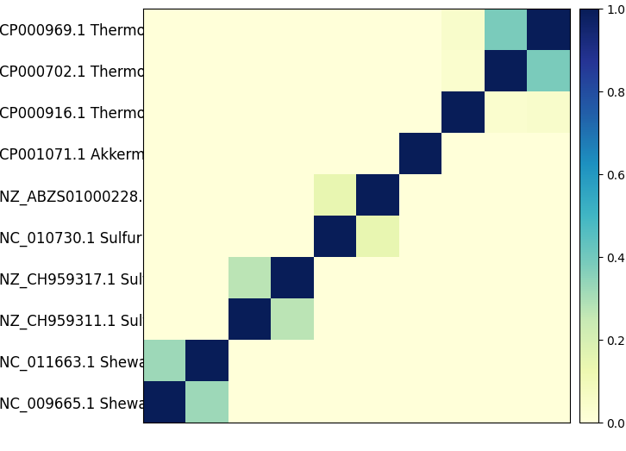
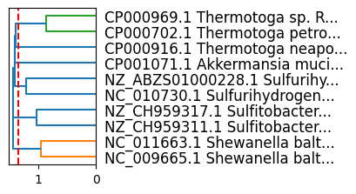
Matrix to dendrogram for 10 samples (Jaccard)
Scikit-learn “linkage” dendrogram.
This is essentially a neighbor joining tree.

Slide 46
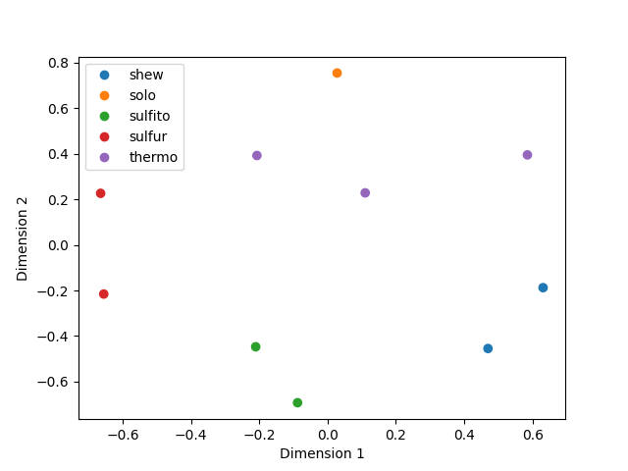
Distance matrices ⬄ dendrograms ⬄ ordination plots

Slide 47
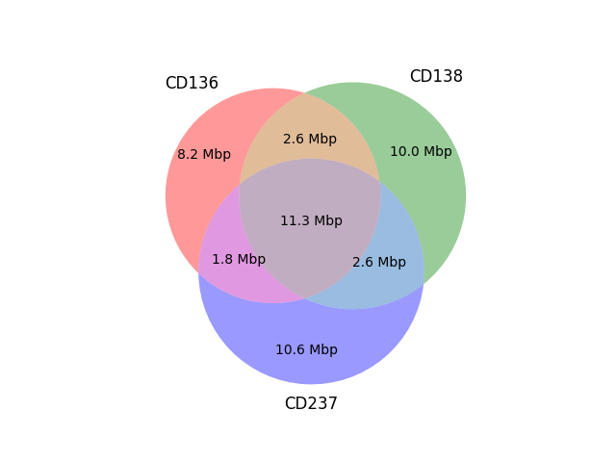
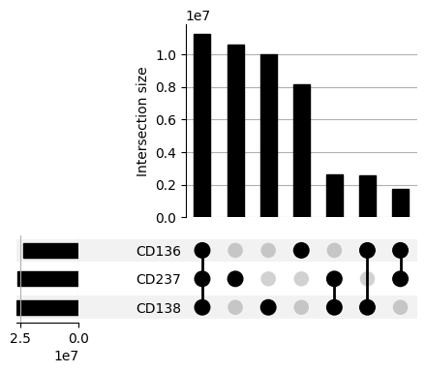
Diagram 1: Metagenome comparison.
K=31, DNA. No abundance.

Slide 48
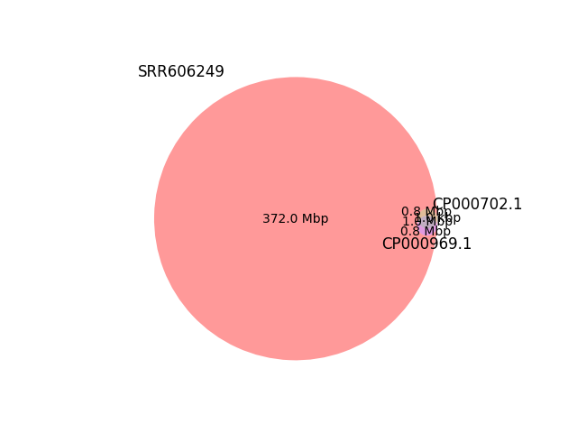
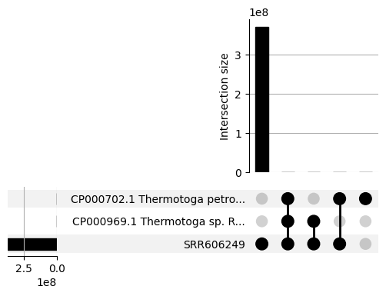
Diagram 2: Genomes and metagenomes
K=31, DNA. No abundance.

Slide 49
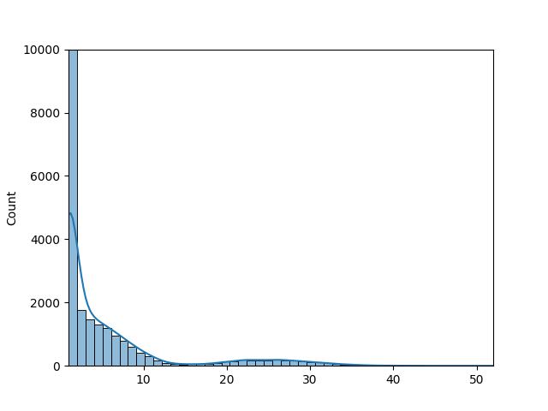
Diagram 3: Abundance histograms of k-mers in metagenomes
K=31, DNA.
With abundance.
Number of k-mers with that multiplicity.
Multiplicity of k-mer (num times observed)

Slide 50
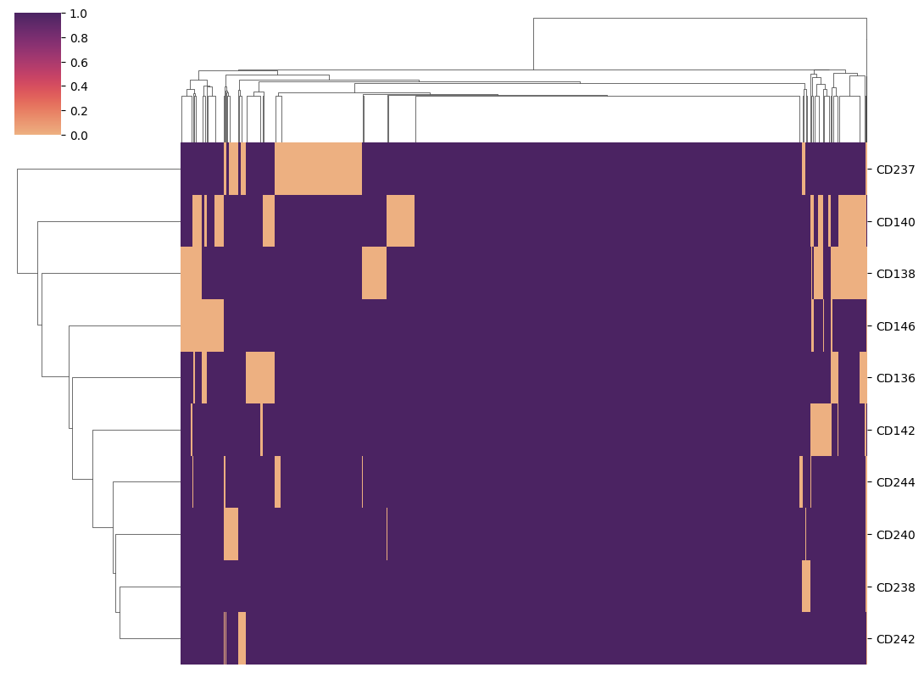
Diagram 4: Presence/absence content plots
K=31, DNA.
10kb regions from known B. fragilis genomes.
No abund.
Metagenome samples
10kb regions (presence/absence)

Slide 51
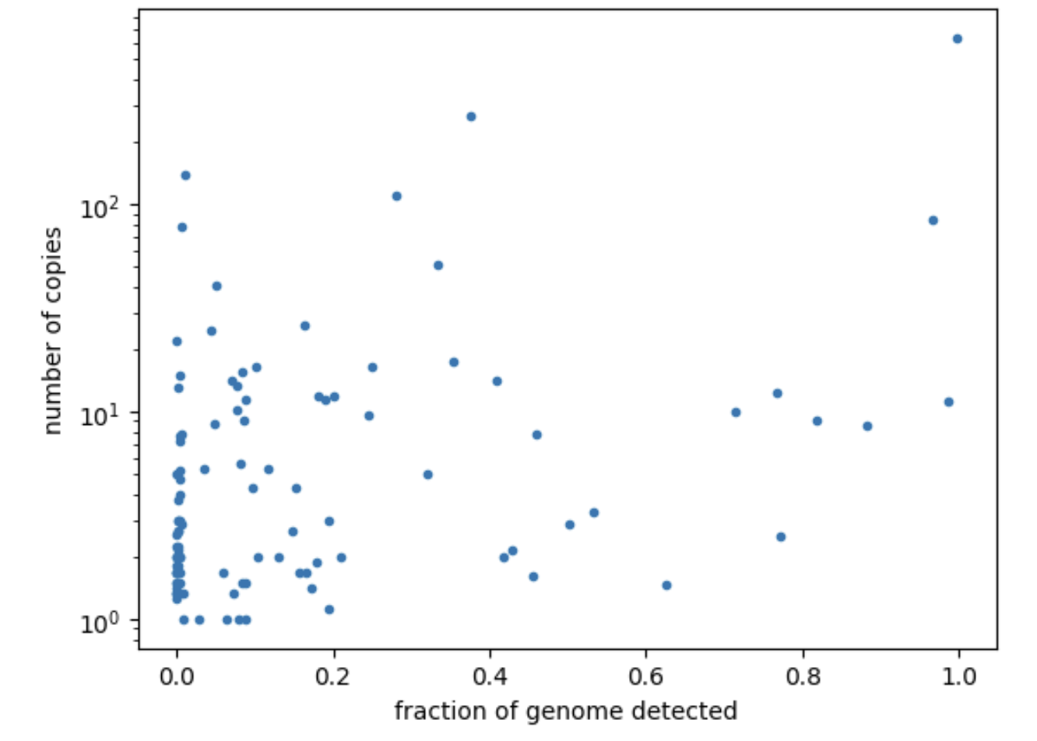
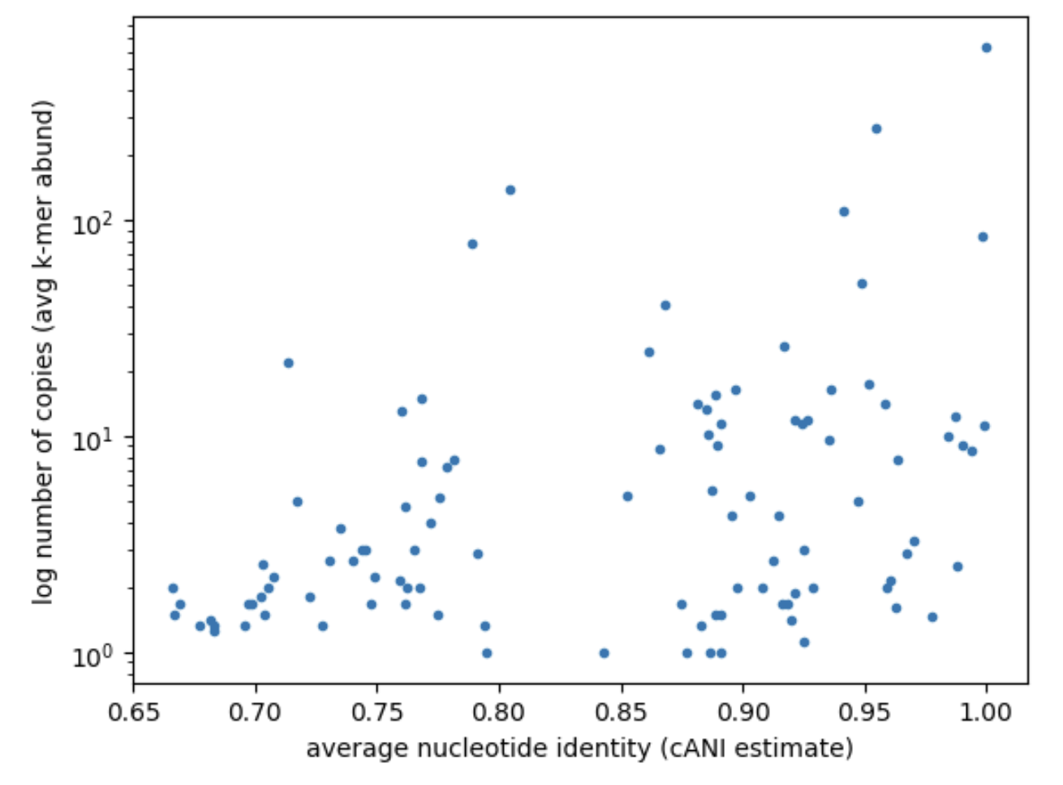
Diagram 5: Which genomes are present in this metagenome?
K=21, DNA. Abund.
All points are robustly observed under a naïve null model.

